Slide 1
What is Artificial Intelligence
AI is a study of how to make computers do things at which, at the moment people are better.
To Attempt any problem that is complex enough for the computer, we require to learn new methods to solve problems than to use conventional methods.
Reference text books:
Elaine Rich, Kevin Knight, Shivashankar B Nair, Artificial Intelligence
Dan W. Patterson, Artificial Intelligence and Expert systems
g

Slide 2
Problems of AI Domain
1. Mundane Tasks
2. Formal Tasks
3. Expert Tasks
Mundane Tasks
Perception
-Vision
- Speech
Natural Language
-Understanding
- Generation
- Translation
Commonsense Reasoning
Robot Control

Slide 3
Formal Tasks
Games
- Chess
- Backgammon
- Checkers-Go
Mathematics
- Geometry
- Logic
- Integral
- Calculus
- Proving properties of programs

Slide 4
Expert Tasks
Engineering
-Design
-Fault Finding
-Manufacturing Planning
Scientific Analysis
Medical Diagnosis
Financial Analysis

Slide 5
To build a system to solve a particular problem , we need to do four things:
Define the problem precisely.
This definition must include precise specification of what the initial situations will be as well as what final situations constitute acceptable solutions to problem.
2. Analyze the problem.
A very few important features can have an immense impact on the appropriateness of various possible techniques for the solving the problem.
3. Isolate and represent the task knowledge that is necessary to solve the problem.
4. Choose the best problem-solving technique and apply it to the particular problem.

Slide 6
State Space Search: Water Jug Problem
“You are given two jugs, a 4-litre one and a 3-litre one.
Neither has any measuring markers on it. There is a pump that can be used to fill the jugs with water. How can you get exactly 2 litres of water into 4-litre jug.”

Slide 7
State Space Search: Water Jug Problem
State: (x, y)
x = 0, 1, 2, 3, or 4 y = 0, 1, 2, 3
Start state: (0, 0).
Goal state: (2, n) for any n.
Attempting to end up in a goal state.

Slide 8
State Space Search: Water Jug Problem
(x, y) → (4, y)
if x < 4
2. (x, y) → (x, 3)
if y < 3
3. (x, y) → (x − d, y)
if x > 0
4. (x, y) → (x, y − d)
if y > 0

Slide 9
State Space Search: Water Jug Problem
5. (x, y) → (0, y)
if x > 0
6. (x, y) → (x, 0)
if y > 0
7. (x, y) → (4, y − (4 − x))
if x + y ≥ 4, y > 0
8. (x, y) → (x − (3 − y), 3)
if x + y ≥ 3, x > 0

Slide 10
State Space Search: Water Jug Problem
9. (x, y) → (x + y, 0)
if x + y ≤ 4, y > 0
10. (x, y) → (0, x + y)
if x + y ≤ 3, x > 0
11. (0, 2) → (2, 0)
12. (2, y) → (0, y)

Slide 11
State Space Search: Water Jug Problem
One solution to Water Jug problem.
Litre in the 4-litre Jug Litre in the 3-litre Jug Rule Applied
0 0
0 3 2
3 0 9
3 3 2
4 2 7
0 2 5 or 12
2 0 9 or 11
2 0

Slide 12
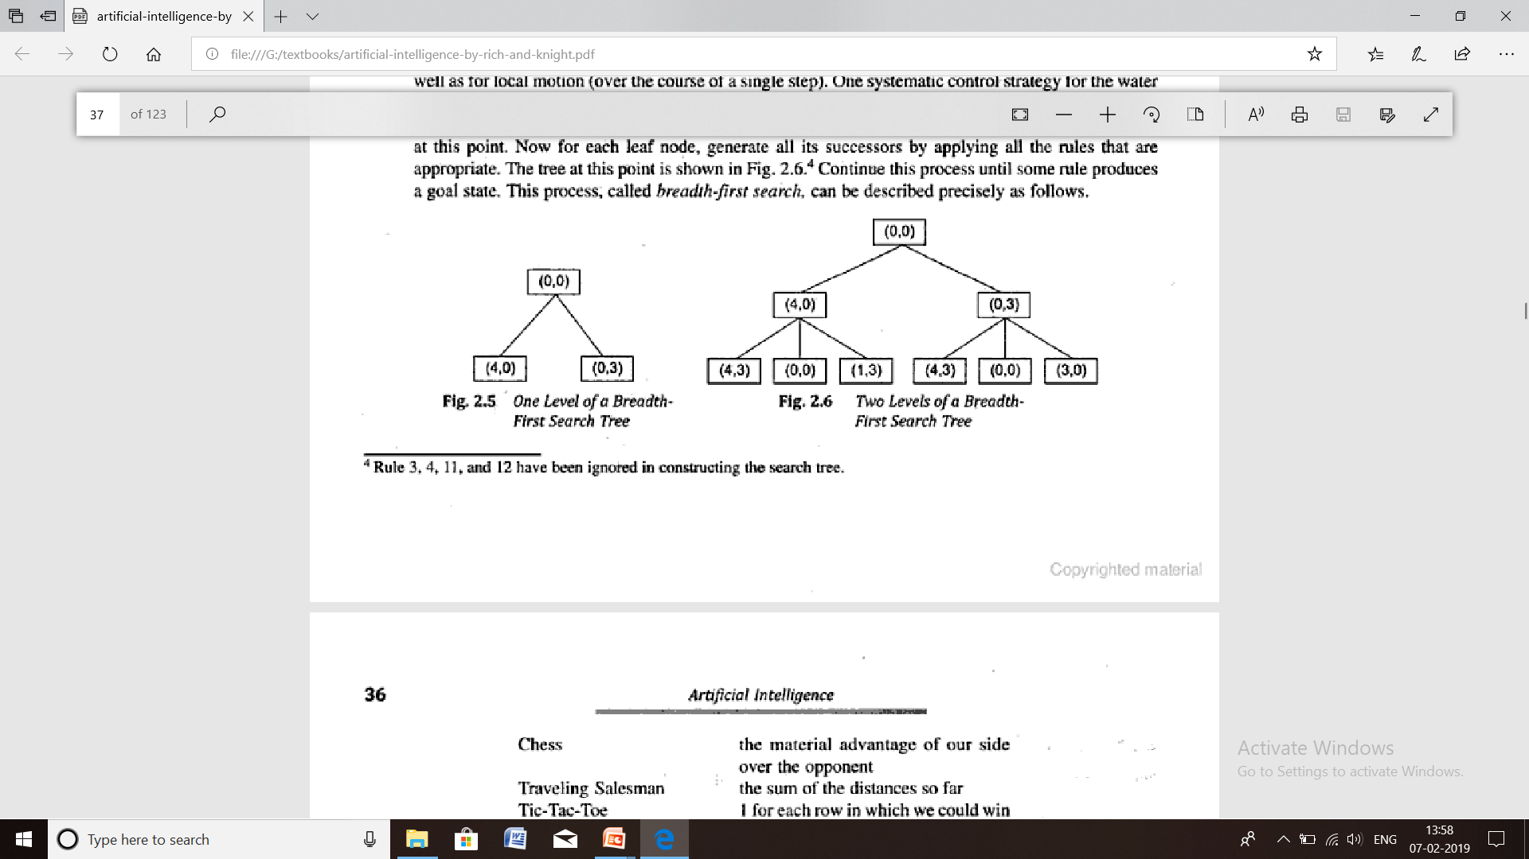

Slide 13
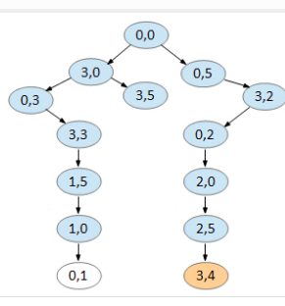
Solution path for 4G using 5G,3G jugs

Slide 14
What is a Production System?
A production system consists of four basic components:
A set of rules of the form Ci → Ai where Ci is the condition part and Ai is the action part. The condition determines when a given rule is applied, and the action determines what happens when it is applied.
2 . One or more knowledge databases that contain whatever information is relevant for the given problem. Some parts of the database may be permanent, while others may temporary and only exist during the solution of the current problem. The information in the databases may be structured in any appropriate manner.
3. A control strategy or search strategy that determines the order in which the rules are applied to the database, and provides a way of resolving any conflicts that can arise when several rules match at once.
4. A rule applier which is the computational system that implements the control strategy and applies the rules.
What is a Production System?
A production system consists of four basic components:
What is a Production System?
A production system consists of four basic components:

Slide 15
Search Strategies
Requirements of a good search strategy:
1. It causes motion
Otherwise, it will never lead to a solution.
2. It is systematic
Otherwise, it may use more steps than necessary.
3. It is efficient
Find a good, but not necessarily the best, answer.

Slide 16
Search Strategies
1. Uninformed search (blind search)
Having no information about the number of steps from the current state to the goal.
2. Informed search (heuristic search)
More efficient than uninformed search.

Slide 17
Algorithm: Breadth First Search
1. Create a variable called NODE_LIST and set it to the initial state.
2. Until a goal state is found or NODE_LIST is empty:
a. Remove the first element from NODE_LIST call it E. If NODE_LIST was
empty, quit.
b. For each way that each rule can match the state described in E do:
i. Apply the rule to generate a new state.
ii. If the new state is a goal state, quit and return this state.
iii. Otherwise, add the new state to the end of NODE_LIST.
Advantages:
Breadth first search will not get trapped exploring a blind alley.
If there is a solution, then breadth-first search is guaranteed to find it.

Slide 19
Algorithm: Depth-First Search
1. If the initial state is a goal state, quit and return success.
2. Otherwise, do the following until success or failure is signaled:
a. Generate a successor, E, of the initial state. If there are no more
successors, signal failure.
b. Call Depth-First Search with E as the initial state.
c. If success is returned, signal success.Otherwise continue in this loop.
Advantages:
Depth-first search requires less memory since only the nodes on the
current path are stored.
By chance, depth-first search may find a solution without examining
much of the search space at all.

Slide 21
Search Strategies: Blind Search
Breadth-first search
Expand all the nodes of
one level first.
Depth-first search
Expand one of the nodes at
the deepest level.

Slide 22
Search Strategies: Blind Search
Criterion | Breadth-First | Depth-First
Time | b^{d} | b^{m}
Space | b^{d} | bm
Optimal? | Yes | No
Complete? | Yes | No
b: branching factor d: solution depth m: maximum depth

Slide 23
Search Strategies: Blind Search
Criterion | Breadth-First | Depth-First
Time
Space
Optimal?
Complete?
b: branching factor d: solution depth m: maximum depth

Slide 24
Heuristics
Heuristic is a technique to guide the search process in the most profitable direction.
Travelling salesman problem
Minimum distance round trip required
If n cities (n-1)! Paths are to be checked leading to combinatorial explosion.
Impossible to complete in reasonable amount of time
Heuristics:
a) general purpose- nearest neighbour heuristic(in prim’s algorithm for minimum cost spanning tree)
Nearest neighbor helps to reduce complexity to O(n²) for travelling salesman problem
b) Problem specific

Slide 25
Chess: material advantage of our side over the opponent
Travelling salesman: sum of the distances so far covered
Tic-tac-toe: a) no. Of rows,columns and diagonals open for one player minus no. of rows, columns and diagonals open for the other player
b)1 for each row which we could win and we have 1 piece in it plus 2 for each row in which we have 2 pieces

Slide 26
The purpose of the heuristic function is to guide the search process in the most profitable direction.
The more good heuristic function the faster will be the solution
Perfect heuristic function finds the solution without any search.
But the cost of computing such a function will outweigh the advantage of saving in search time

Slide 27
Heuristics can be used to control the search or it can be hard coded in the rules.
In both cases knowledge about problem domain is used to find feasible solution to hard problems
AI means the study of techniques to solve exponentially hard problems in polynomial time by making use of knowledge of problem domain

Slide 28
Two ways by which heuristics can be added into a rule based search procedure
i) In the set of rules themselves
ii)As a heuristic function that evaluates problem states
The solution we get through heuristics may not be optimal but it gives a better solution than the worst case solution.

Slide 29
Problem characteristics
Is the problem decomposable
Can the steps be ignored or undone
Is the universe predictable
Is the solution a state or a path
Is a solution obvious without comparing to all possible solutions
Is large amount of knowledge required for the solution or knowledge required just to constarin the search
Is the problem given to the system and it returns the result or does it require interaction between the user and system

Slide 30
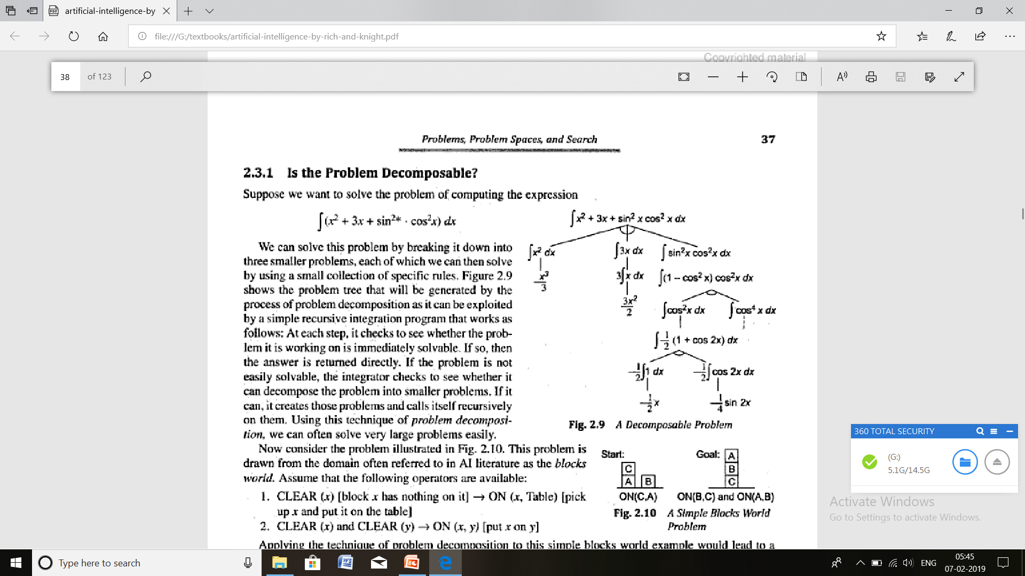
Is problem decomposable?

Slide 31
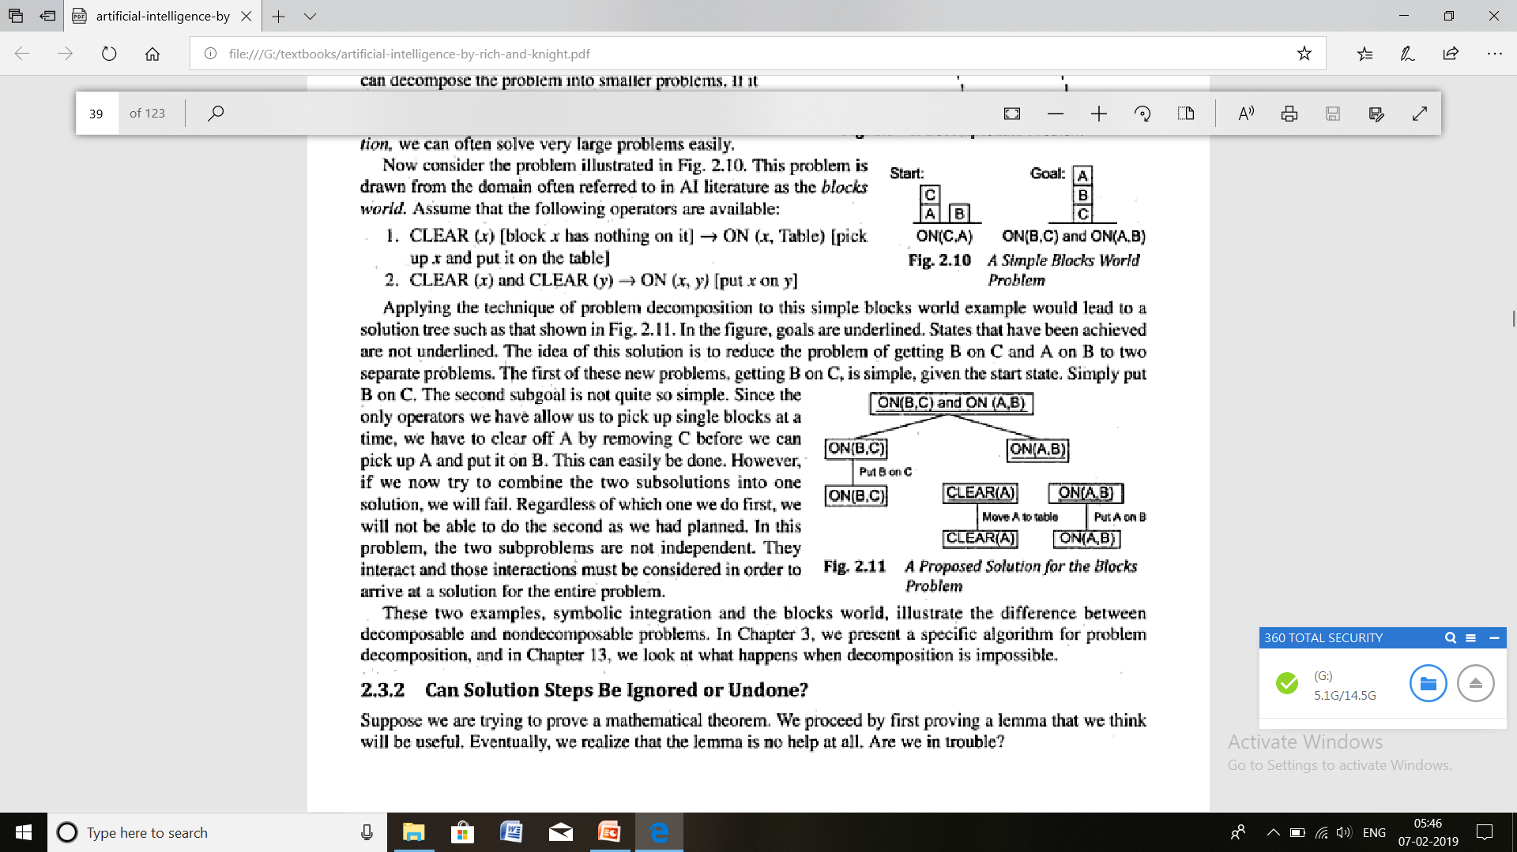
Blocks world problem

Slide 32
Can the steps be ignored or undone?
Problems can be i) ignorable
Prooving mathematical theorems. Steps applied can be ignored and start from the beginning
ii) recoverable
8 puzzle: steps can be undone if the steps are found to be incorrect
iii) Irrecoverable: (chess)

Slide 33
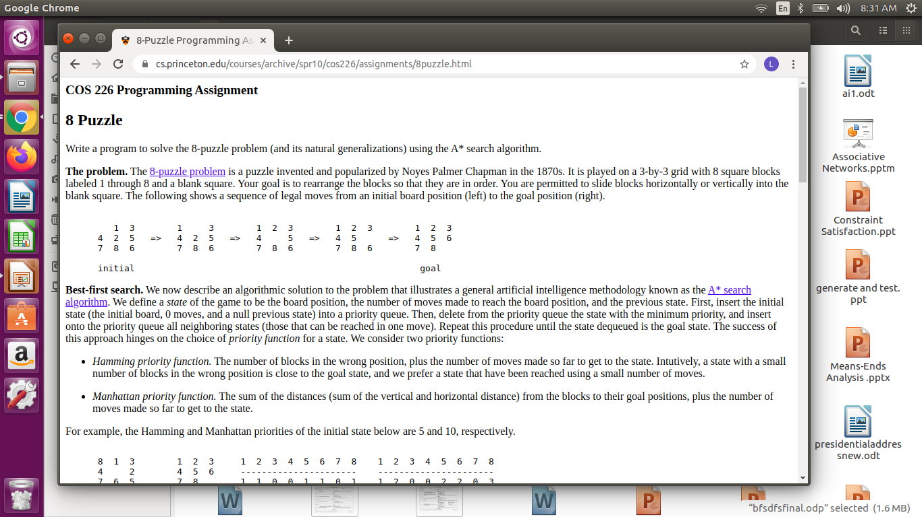
8- puzzle

Slide 34
Universe predictable?
Certain outcome
8-puzzle, the board is open and we can plan well without a feedback
Uncertain outcome
Bridge requires careful plan with feedback as the cards in other hands as well as the moves of the players can not be predicted. A plan revision from the planning sequence and necessary feedback is provided.
Controlling a robot arm
Helping a lawyer to defend his client against amurder charge

Slide 35
Is solution absolute or relative
Any bath or best path problems
Question answering- not absolute. Any One justification is required. Can be solved in a reasonable amount of time with good heuristics. If the heuristics is wrong the solution can still be found with some additional search.
Travelling salesman – absolute. It requires the round trip path with the shortest distance. Heuristics should not miss the best path.

Slide 36
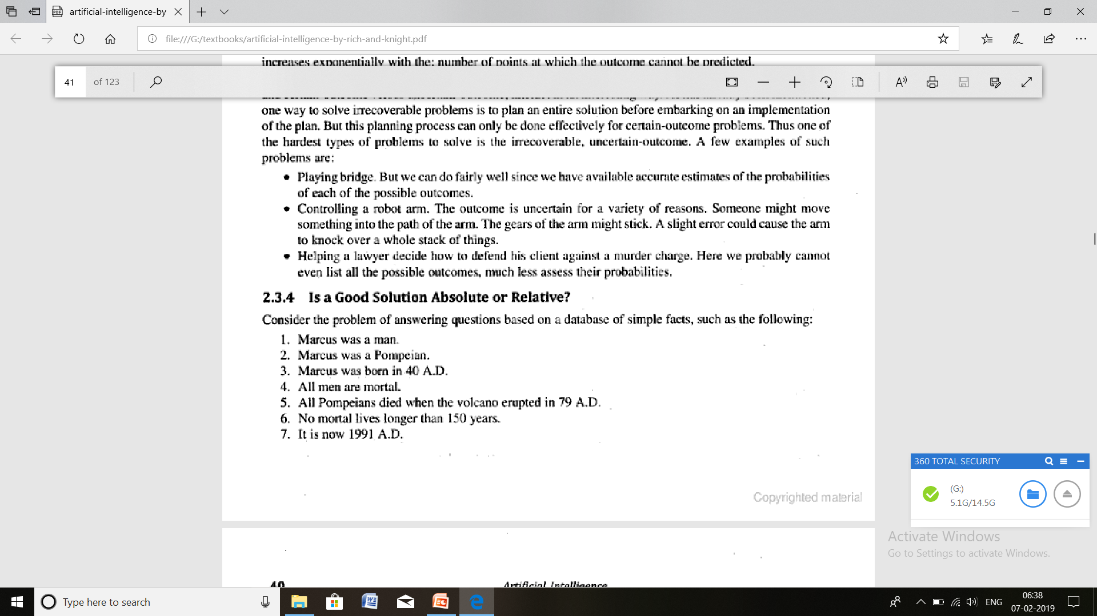

Slide 37
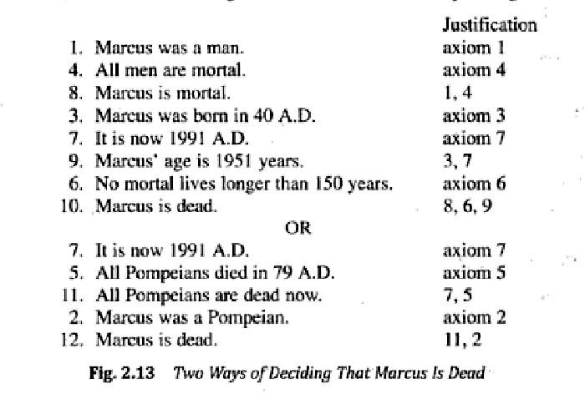

Slide 38
Solution a path or state?
a)Consistent interpretation for the sentence-
The bank president ate a dish of pasta salad with a fork
Requires search regarding bank,
ate dish/pasta salad,
pasta salad means salad made from pasta whereas dog food means food for dog
With the fork attaches to verb whereas with vegetables will be different
b)Water jug problem requires a path than a state

Slide 39
Knowledge required
a)playing chess: less knowledge required
b)Scanning the newpapers to decide which support democrats ahich support republicans: lot of knowledge

Slide 40
Solitary or conversational
Solitary- solution with no intermediate communication and with no demand for an explanation of the reasoning process.
e.g:- question answering, mathematical theorem proving
If all we want is whether there a proof for the theorem, then the program can adopt any method like resolution and give the answer.
Conversational- There is inremediate communication between system and the user, either to provide additional assistance to the system or to provide additional information to the user or both
e.g:- geometrical theorm proving. If the theorem is sufficiently difficult, better directions can be input by the user.

Slide 41
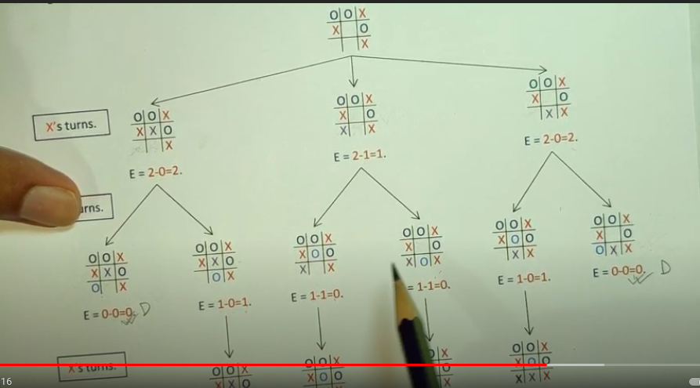
Tic tac toe state space and heuristics

Slide 42
Heuristic Search techniques
There are a number of methods used in Heuristic Search techniques
  Depth Search
  Breadth Search
  Hill climbing
  Generate-and-test
  Best-first-search
  Problem reduction
  Constraint satisfaction
  Means-ends analysis

Slide 43
Generate and Test
The generate-and-test strategy is the simplest of all the approaches.
It is a very simple algorithm that guarantees to find a solution if done systematically and there exists a solution.
The generate-and-test algorithm is a depth-first search procedure since complete solutions must be generated before they can be tested.
It can also operate by generating solutions randomly, but then there is no guarantee that a solution will be ever found.
The generate-and-test strategy is the simplest of all the approaches.
It is a very simple algorithm that guarantees to find a solution if done systematically and there exists a solution.
The generate-and-test algorithm is a depth-first search procedure since complete solutions must be generated before they can be tested.
It can also operate by generating solutions randomly, but then there is no guarantee that a solution will be ever found

Slide 44
Generate and Test
ALGORITHM
  Step 1 : Generate a possible solution. For some problems, this means generating a particular point in the problem space. For others, it means generating a path from a start state.
  Step 2 : Test to see if this is actually a solution by comparing the chosen point or the end point of the chosen path to the set of acceptable goal state.
  Step 3 : If solution has been found quit. Otherwise return to step 1.

Slide 45
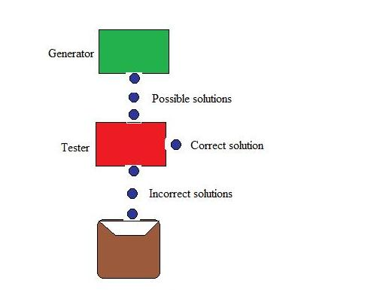
Generate and Test
FIGURE

Slide 46
Generate and Test
Generate-and-test, like depth-first search, requires that complete solutions be generated for testing.
In its most systematic form, it is only an exhaustive search of the problem space. Solutions can also be generated randomly but solution is not guaranteed.
This approach is what is known as British Museum algorithm: finding an object in the British Museum by wandering randomly.
Generate-and-test, like depth-first search, requires that complete solutions be generated for testing.
In its most systematic form, it is only an exhaustive search of the problem space. Solutions can also be generated randomly but solution is not guaranteed.
This approach is what is known as British Museum algorithm: finding an object in the British Museum by wandering randomly

Slide 47
Generate and Test
Exhaustive generate-and-test is very useful for simple problems. But for complex problems even heuristic generate-and-test is not very effective technique. But this may be made effective by combining with other techniques in such a way that the space in which to search is restricted.
For problems much harder than this, even heuristic generate-and-test, is not very effective technique.
It is better to be combined with other techniques to restrict the space in which to search even further, the technique can be very effective.
Exhaustive generate-and-test is very useful for simple problems. But for complex problems even heuristic generate-and-test is not very effective technique. But this may be made effective by combining with other techniques in such a way that the space in which to search is restricted.
For problems much harder than this, even heuristic generate-and-test, is not very effective technique.
It is better to be combined with other techniques to restrict the space in which to search even further, the technique can be very effective

Slide 48
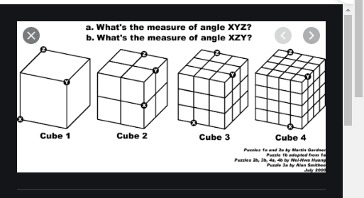

Slide 49
Example: coloured blocks
“Arrange four 6-sided cubes in a row, with each side of
each cube painted one of four colours, such that on all four
sides of the row one block face of each colour is showing.”
Heuristic: if there are more red faces than other colours
then, when placing a block with several red faces, use few
of them as possible as outside faces.

Slide 50
Hill Climbing
In hill climbing the basic idea is to always head towards a state which is better than the current one. It is a depth first approach.
So, if you are at town A and you can get to town B and town C (and your target is town D) then you should make a move IF town B or C appear nearer to town D than town A does.
In hill climbing the basic idea is to always head towards a state which is better than the current one. It is a depth first approach.
So, if you are at town A and you can get to town B and town C (and your target is town D) then you should make a move IF town B or C appear nearer to town D than town A does

Slide 51
Hill Climbing
The hill-climbing algorithm chooses as its next step the node that appears to place it closest to the goal (that is, farthest away from the current position).
It derives its name from the analogy of a hiker being lost in the dark, halfway up a mountain. Assuming that the hiker’s camp is at the top of the mountain, even in the dark the hiker knows that each step that goes up is a step in the right direction.
The hill-climbing algorithm chooses as its next step the node that appears to place it closest to the goal (that is, farthest away from the current position).
It derives its name from the analogy of a hiker being lost in the dark, halfway up a mountain. Assuming that the hiker’s camp is at the top of the mountain, even in the dark the hiker knows that each step that goes up is a step in the right direction.

Slide 52
Simple hill climbing
The key difference between this algorithm and the one for generate and test is the use of an evaluation function as a way to inject task-specific knowledge into the control process.
Algorithm
Step 1 : Evaluate the initial state.
Step 2 : Loop until a solution is found or there are no new operators left to be applied:
− Select an untried operator and apply to the current state.
− Evaluate the new state:
i) if goal return and quit
ii) if better than current state make the new state current state

Slide 53
Example: coloured blocks
Heuristic function: the sum of the number of different
colours on each of the four sides (solution = 16)

Slide 54
Steepest-Ascent Hill Climbing
Considers all the moves from the current state.
Selects the best one as the next state.
Also called Gradient search.

Slide 55
Algorithm:
1. Evaluate the initial state. If it is also a goal state, then return it and quit. Otherwise, continue with the initial state as the current state.
2. Loop until a solution is found or until a complete iteration produces no change to current state:
(a) Let SUCC be a state such that any possible successor of the current state will be better than SUCC.
(b) For each operator that applies to the current state do:
(i) Apply the operator and generate a new state.
(ii) Evaluate the new state. If it is a goal state, then return it and quit. If not, compare it to SUCC. If it is better, then set SUCC to this state. If it is not better, leave SUCC alone.

Slide 56
Steepest –ascent hill climbing may fail to find solution. The algorithm may terminate not by finding a goal state but by getting to a state from which no better states an be generated.
This will happen if the program has reached either local maximum, Plateau or a ridge.
Local maximum:
-> A state that is better than all of its neighbours, but not better than some other states far away.
Fig1- Local maximum

Slide 57
Plateau:
-> A flat area of the search space in which all neighbouring states have the same value.

Slide 58
Ridge:
-> The orientation of the high region, compared to the set of available moves, makes it impossible to climb up. However, two moves executed serially may increase the height.
Ways Out
Backtrack to some earlier node and try going in a different direction.
Make a big jump to try to get in a new section.
Moving in several directions at once.
Fig3-Ridge

Slide 59
Backtrack to some earlier node and try going in a different direction. This is particularly reasonable if at that node there was another direction that looked promising or almost as promising as the one that was chosen earlier. To implement this strategy, maintain a list of paths almost taken and go back to one of them if the path that was taken leads to a dead end. This is a fairly good way of dealing with local maxima.
Make a big jump in some direction to try to get to a new section of the search space. This is a particularly good way of dealing with plateaus. If the only rules available describe single small steps, apply them several times in the same direction.
Apply two or more rules before doing the test. This corresponds to moving in several directions at once. This is a particularly good strategy for dealing with ridges.

Slide 60
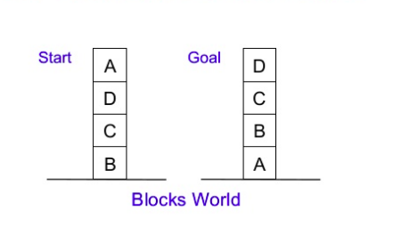

Slide 61
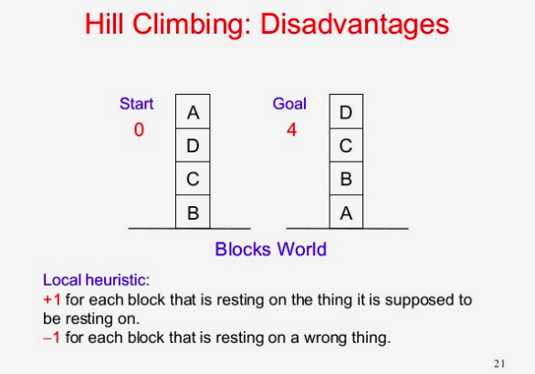

Slide 62
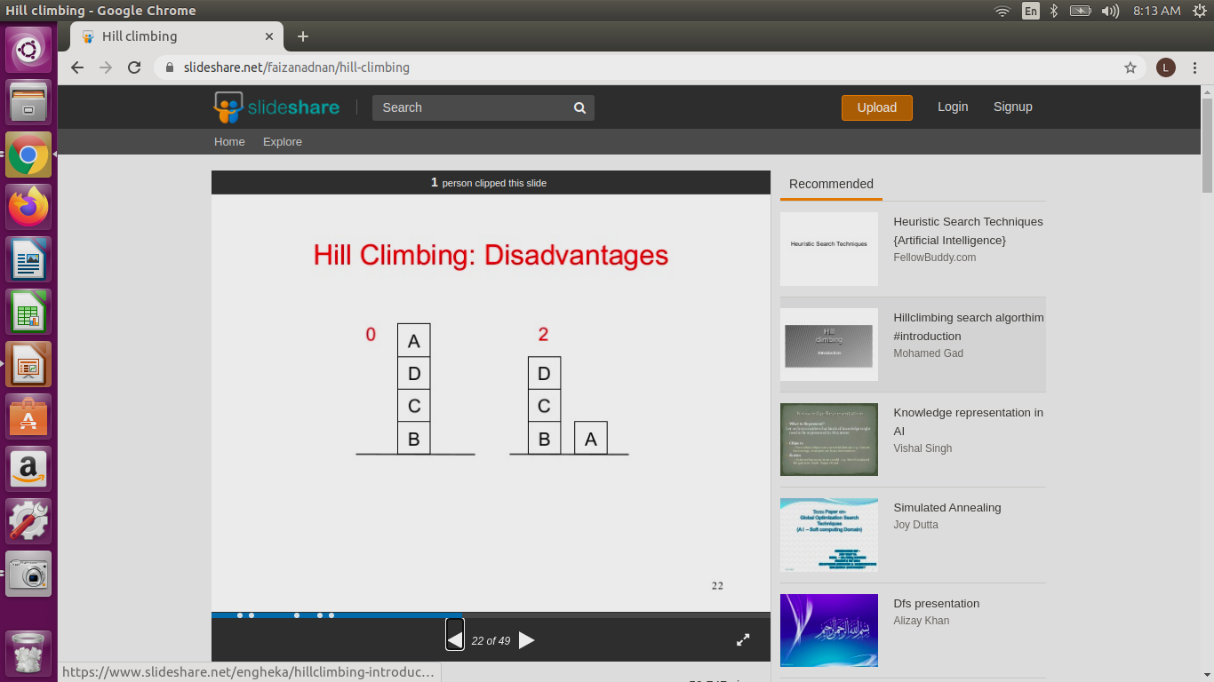
1 point for every block that is resting on the thing it is supposed to be resting on.
-1 point for every block that is sitting on the wrong thing.

Slide 63
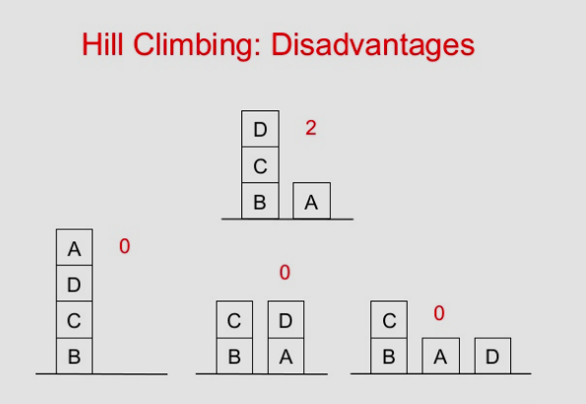
1 point for every block that is resting on the thing it is supposed to be resting on.
-1 point for every block that is sitting on the wrong thing.

Slide 64
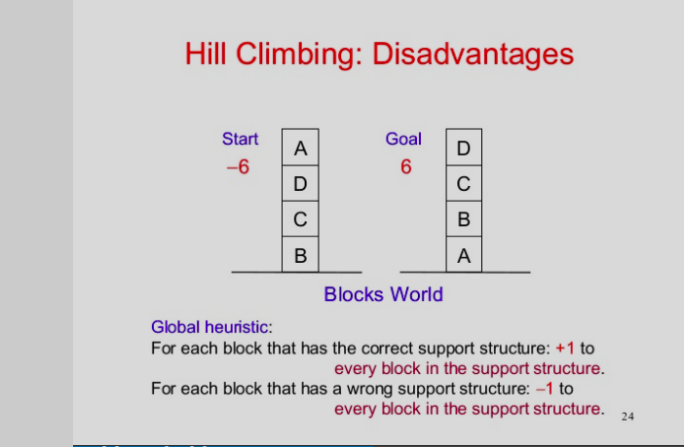

Slide 65
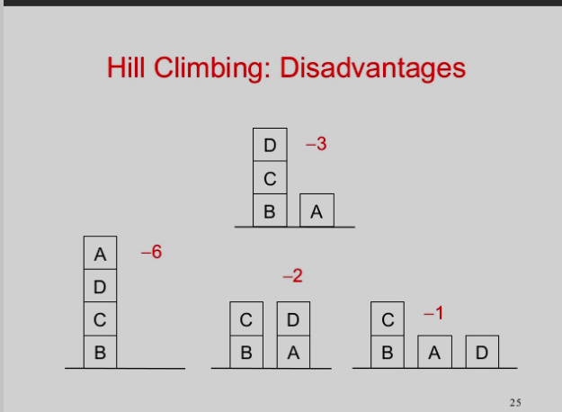
For each block that has the correct support structure (i.e., the complete structure underneath it is exactly as it should be), 1 point for every block in the support structure.
For each block that has an incorrect support structure, -1 point for every block in the existing support structure.

Slide 66
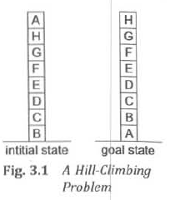
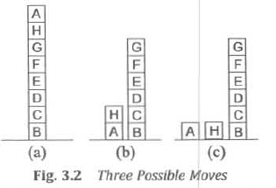

Slide 67
Local evaluation function:
1 point for every block that is resting on the thing it is supposed to be resting on.
-1 point for every block that is sitting on the wrong thing.
Global evaluation function:
For each block that has the correct support structure (i.e., the complete structure underneath it is exactly as it should be), 1 point for every block in the support structure.
For each block that has an incorrect support structure, -1 point for every block in the existing support structure.

Slide 68
Local function produces scores
Initial state:4
Moving A to table: 6
a)4 b)4 c)4
Global function produces scores
Initial state :-28
Moving A to table : -21
a)-28 b)-16 c)-15

Slide 69
Conclusion
Can be very inefficient in a large, rough problem space.
Global heuristic may have to pay for computational complexity.
Often useful when combined with other methods, getting it started right in the right general neighbourhood.

